Slide 1
FACIAL RECOGNITION SYSTEMS
MIS 695 Project Presentation
-Presented by: Kiran Varma Kolukuluri Roshini Padmanabha Sharon Sowmya Tolety

Slide 2
INTRODUCTION
01
02
SYSTEM DESIGN
IMPORTANCE OF
FACE RECOGNITION
03
04
CODE & RESULTS
FUTURE ENHANCEMENTS
& CONCLUSION

Slide 3
WHY FACIAL RECOGNITION SYSTEMS ARE USEFUL?
1. Verifying identities in banking or e-commerce transactions to prevent real-time fraud.
2.Improves user experience by enabling interaction through gestures & facial expressions.
3.It is utilized in the surveillance systems in identifying and tracking individuals in real-time.
4.It can be helpful in creating tools for visually impaired individuals by recognizing faces and providing audio cues.

Slide 4
WHAT PROBLEMS DOES FACIAL RECOGNITION SYSTEMS SOLVE?
Identity Verification: Verifying someone's identity and recognizing a person in an image.
Retail and Advertising: Facial recognition systems can analyze an individual’s appearance and mood to display targeted advertisements.
Smart Home Systems: Identify unauthorized individuals and send alerts to homeowners or security services in real-time.
Health Monitoring: Detecting signs of distress, pain, or fatigue in patients for timely intervention.

Slide 5
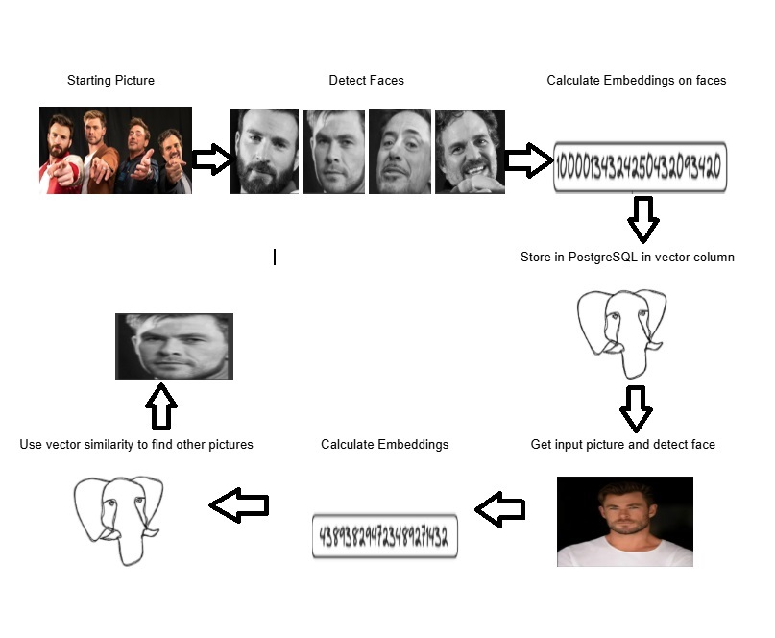
Embeddings

Slide 6
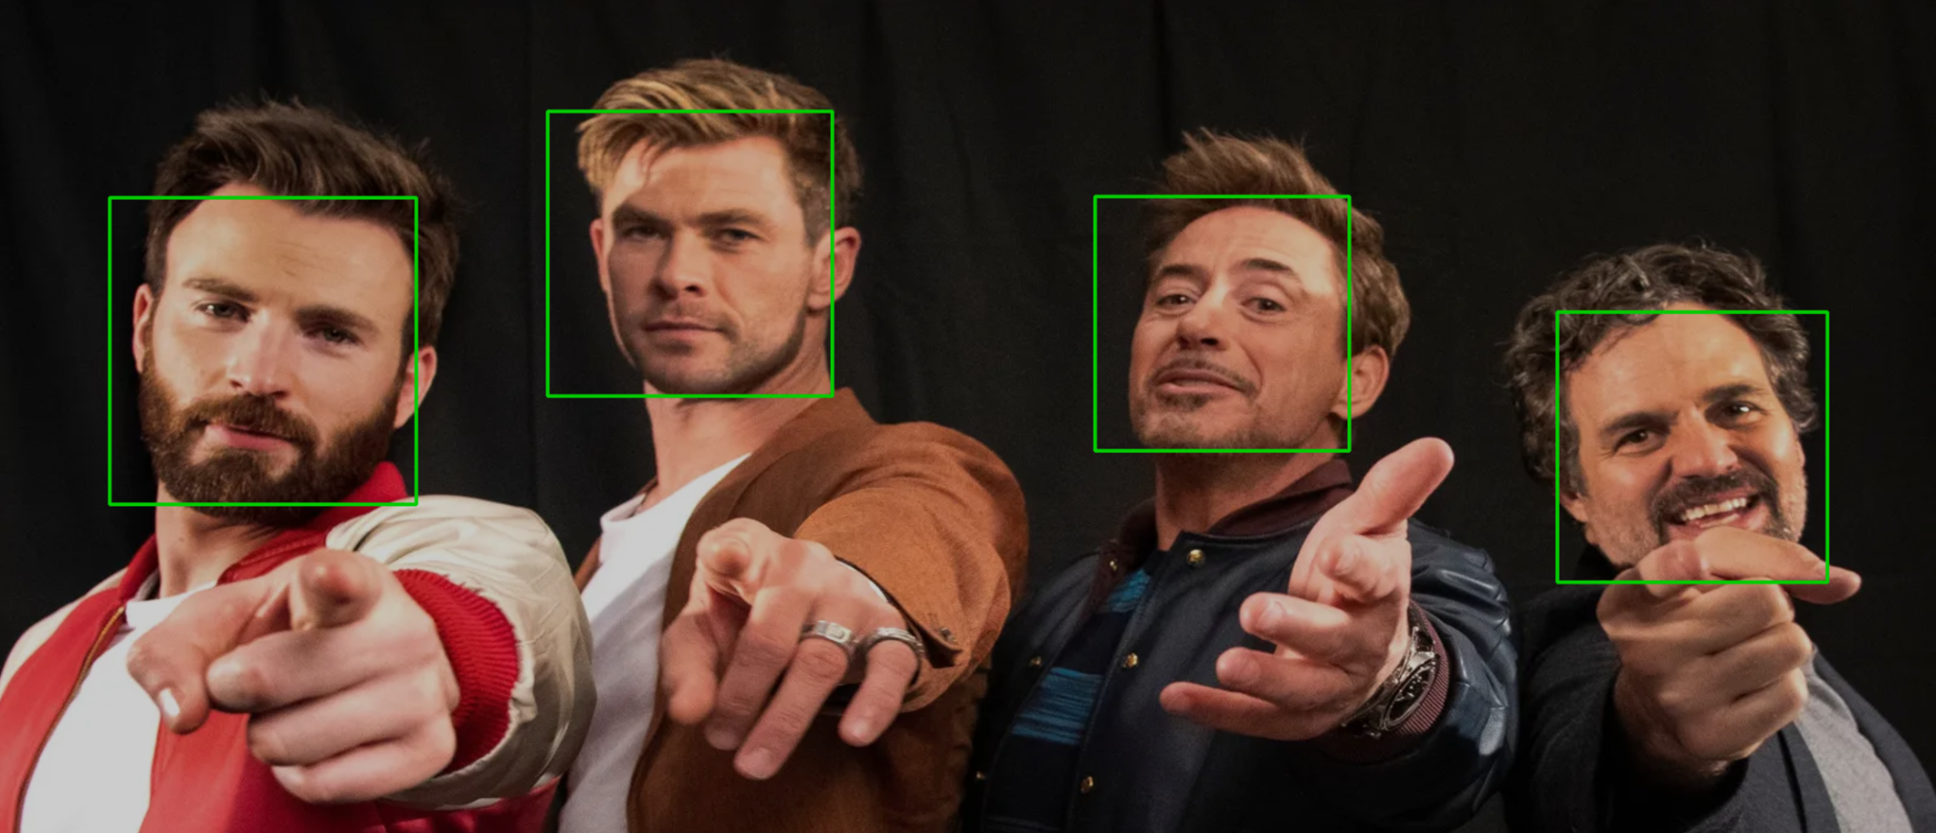
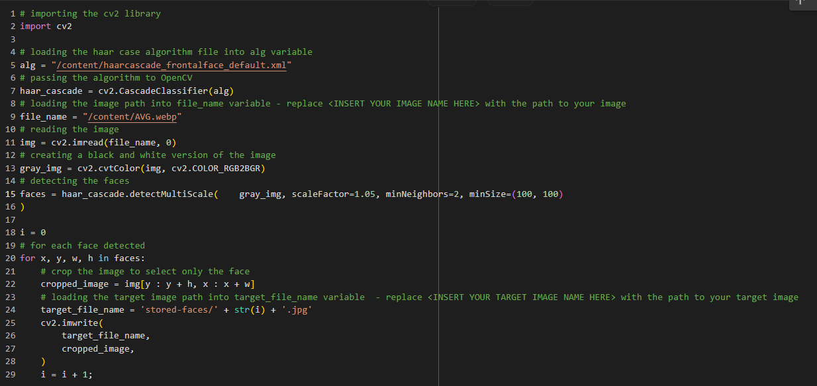

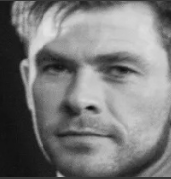

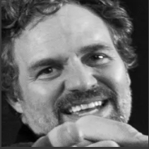
Step 1: Face recognition Detect the faces from the test-image picture and store them under the stored-faces folder

Slide 7


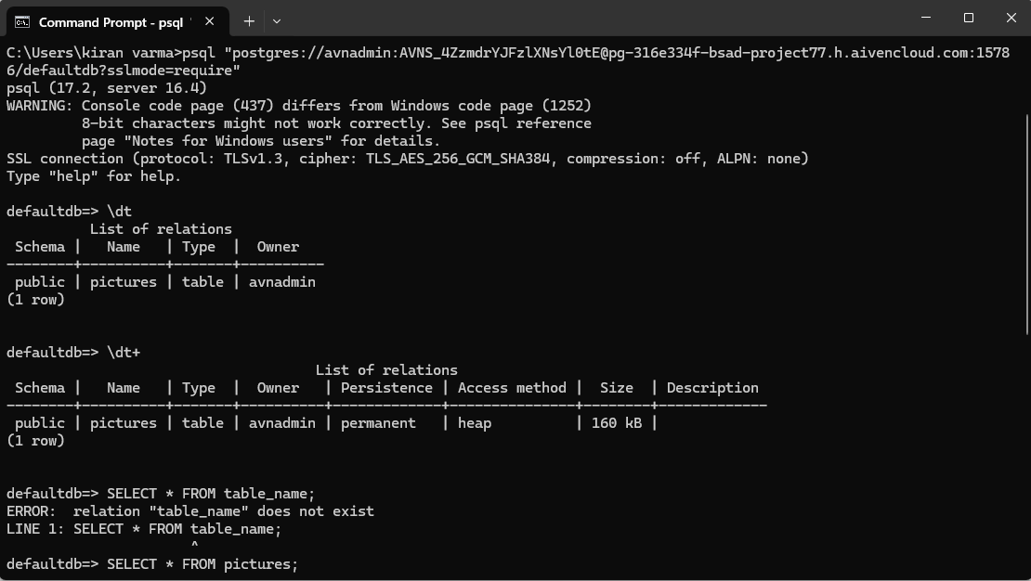
Step 2: Calculate embeddings from the faces and pushing to PostgreSQL, & we need to change the parameter with the PostgreSQL Service URI

Slide 8

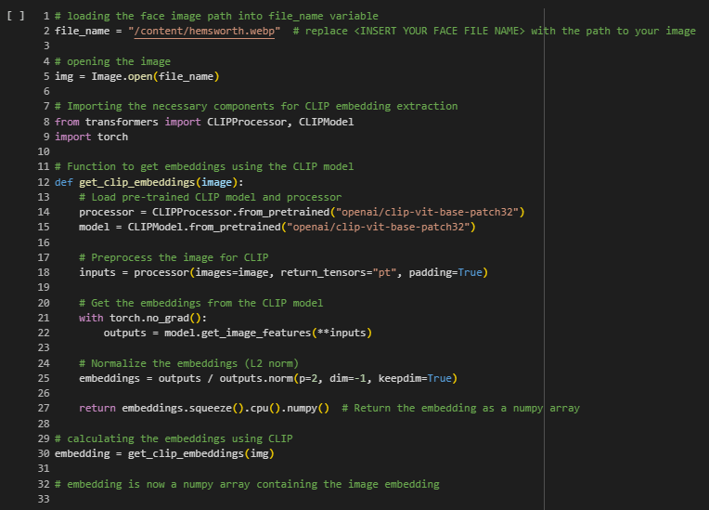
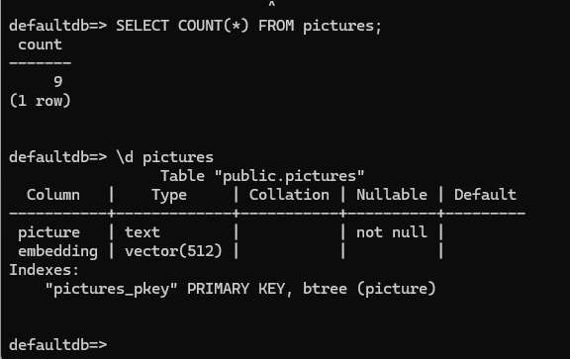
Step 3: Find the face and calculate the embeddings on the picture hemsworth.webp used for research

Slide 9
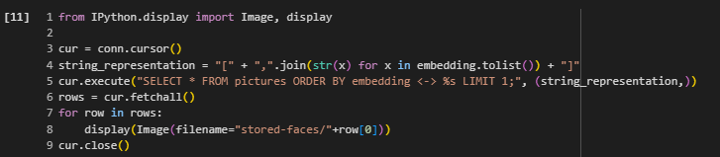
Step 4: Find the face and calculate the embeddings on the picture hemsworth.webp used for research

Slide 10


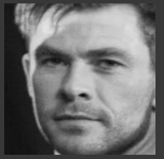
Step 4: Find similar images by querying the Postgresql database using pgvector
Training Picture
Input
Output

Slide 11
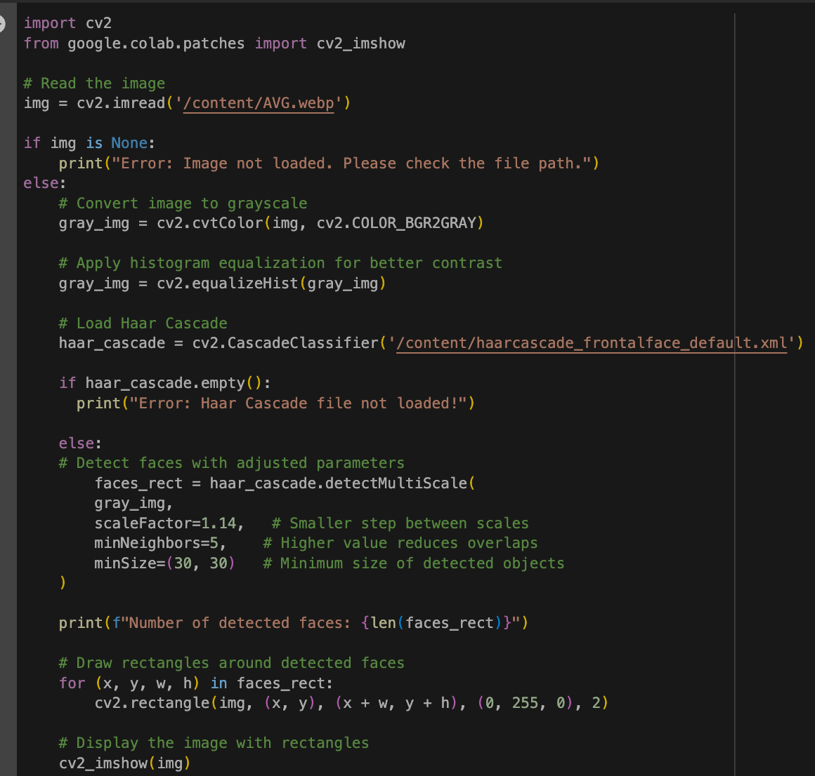
Face Detection with OpenCV

Slide 12
RESULTS
PostgreSQL + pg vector Model
Enhanced facial recognition by creating a database of face embeddings.
Key Features:
Efficiently stored vectorized face representations for similarity matching.
Achieved high accuracy in comparing uploaded images against stored embeddings.
Advantages:
Scalable solution for larger datasets.
Enabled rapid and precise face similarity searches.
Haar Cascade-Based Model
Successfully detected faces in images and live webcam feeds.
Performance: Detected up to 8 faces per image with bounding boxes.
Limitations: Overlaps occasionally occurred in crowded scenes. Struggled with varying lighting conditions and small faces.

Slide 13
FUTURE ENHANCEMENTS
Model Upgrades: Replace Haar Cascade with deep learning models like FaceNet or MTCNN for higher accuracy.
Embedding Optimization: Improve similarity matching with cosine distance. Use dimensionality reduction (e.g., PCA) for better performance.
Scalability: Deploy on cloud platforms (AWS/GCP) for large-scale applications. Integrate with streaming tools like Kafka for real-time recognition.
Real-Time Features: Add live detection via webcam or video feeds.
Enhance system usability with a web or mobile app.
Security & Privacy: Encrypt embeddings and adopt federated learning for data privacy.

Slide 14
THANK YOU!!

